Slide 1
7th annual national public sector fraud AND corruption congress adopting a robust fraud-risk MANAGEMENT framework
Post-Conference Executive Workshop
28 July 2017

Slide 2
Workshop Roadmap
Introduction
Workshop Objectives
Topical Modules
Case Studies in Fraud-Risk Management
Open Discussion
Concluding Thoughts
Addenda

Slide 3
Introduction (I)
Fraud represents an insidious risk to the integrity of and erodes vital public trust in government programs at a time of significant fiscal pressures
Public enterprise executives and managers are challenged to take a strategic approach to counter fraud risks and develop effective measures to manage these risks
Workshop builds on themes and concepts introduced during keynote presentation and goes in depth for selected topics that are fundamental to effective fraud-risk management
Focuses on the imperatives and intricacies of performing robust risk assessments, creating comprehensive risk profiles, and integrating them to inform executive decision-making

Slide 4
Introduction (II)
Risk assessments and profiles are the principal underpinnings of a proactive, action-oriented fraud-risk strategy and its component objectives & activities
Successful implementation of such a strategy is intended to offer reasonable assurance that a program’s mission is being met and that taxpayer investments are safeguarded
Without getting the fundamentals right and sustaining them over time, fraud-risk strategies and related activities become unmoored in their purpose and effectiveness
Ultimately, any fraud-risk management model must address how to reconcile delivering benefits timely with the need to safeguard program integrity & underlying investments

Slide 5
Workshop Objectives
Acquire fundamentals for creating and implementing a comprehensive strategy to manage complex fraud risks
Share and discuss common and unique experiences and glean lessons & insights to apply in future anti-fraud efforts

Slide 6
Topical Module Outline
Module I: Strategic Context
Module II: Fundamentals of Successful Fraud-Risk Management
Module III: Overview of GAO Fraud-Risk Management Framework
Module IV: Principle #1—Prevention
Module V: Principle #2—Detection
Module VI: Principle #3—Response
Module VII: Component #1—Commit
Module VIII: Component #2—Assess
Module IX: Component #3—Design & Implement (Strategy)
Module X: Component #4—Evaluate & Adapt

Slide 7
Module I: Strategic Context
Re-frame and couch fraud-risk management within overarching, strategic context (“big-picture”) of program integrity
Shift thinking on and “culture” of fraud-risk management from reactive (passive) to proactive posture
Adhere to simple but key fundamentals, do them well, & firmly embed in enterprise’s overall business & risk models

Slide 8
Module II: Fundamentals of Successful Fraud-Risk Management
Unequivocal executive policy choice supported by sustained high-level commitment & attention (tone-at-top)
Aligned with enterprise-wide mission & strategy, with outcome-oriented, risk-appropriate metrics
Embedded in core business model & ERM structure
Coordinated across internal/external stakeholder universe (vertical, horizontal)
Bundled with other approaches (e.g., deep data analytics, probing investigative techniques) as force multipliers
Implemented in systematic, flexible/iterative manner to respond to dynamic operating environment & evolving risks (agility of response)

Slide 9
Module III: Overview of GAO Fraud-Risk Management Framework
Principles
  Prevention
  Detection
  Response
Components
  Commit
  Assess
  Design & Implement
  Evaluate & Adapt

Slide 10
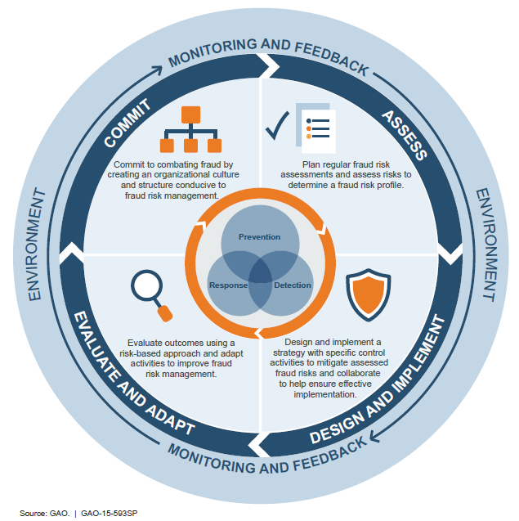
Module III: Multilayer Representation of Fraud Risk Framework

Slide 11
Module IV: Principle #1—Prevention
Cost-effective, proactive posture versus reactive and ineffective “pay-and-chase” approach (prevailing)
  → Mitigate the risk from occurring
  Illustrative control activities include—
    Comprehensive anti-fraud strategy
    Fraud awareness training for employees at all levels
    Initial data analytics to verify program eligibility
    Segregation of duties, approvals, active supervisory chain
    Standards of conduct
    Transaction limits

Slide 12
Module V: Principle #2—Detection
Quick detection as deterrent effect, buttressed by likelihood of subsequent consequence
  → Discover potential fraud that has already occurred
  Illustrative control activities include—
    Detailed audits with appropriate investigative components
    Comprehensive follow-on data analytics combining matching, mining, prediction
    Document reviews and cross-corroboration from multiple sources
    Site visits & inspections and interviews with personnel

Slide 13
Module VI: Principle #3—Response
Decisive action, with lessons-learned feedback loop to inform future prevention and detection posture
  → Investigate potential fraud, take corrective action, & remedy harm
  Illustrative control activities include—
    Follow-on in-depth investigations
    Prosecutions of well-developed cases
    Disciplinary actions
    Suspensions and debarments of vendors
    Payment denials and recoveries

Slide 14
Module VII: Component #1—Commit
Create and sustain organizational culture
  Establish an institutional environment that is welcoming and conducive to fraud-risk management—function of
    Clear & unambiguous policy choice and executive-level commitment & leadership (tone at top) as key long-term drivers
    Devolution to and embedding in all levels of enterprise and across stakeholder universe to establish ownership and common purpose
Establish fraud-risk management structure
  Designate a well-resourced, empowered entity to implement proactive fraud-risk management—core functions include
    Understanding operational environment and inherent risks & controls
    Reporting directly to executive management with full authorities
    Performing assessments, creating strategy, & monitoring performance

Slide 15
Module VIII: Component #2—Assess
Part 1: Risk Assessment
Risk assessment is the core driver for successful risk-mitigation response—key considerations and activities include (see Addendum 1 for further details)
  Tailor assessment to unique aspects of program design & complexity (e.g., regulations, rules, processes & procedures, volume of transactions, beneficiary & provider expectations, etc.)
  Conduct assessment at regular intervals to keep pace with changing operational circumstances and evolving risks
  Involve full slate of internal and external stakeholders with knowledge of the program and its intricacies
  Identify tools, methods, and sources for gathering & analyzing information on fraud risks, including specific schemes & trends

Slide 16
Module VIII: Component #2—Assess
Part 1: Risk Assessment (Continued)
Key considerations and activities (continued)
  Identify inherent internal & external fraud risks affecting the program from provider, beneficiary, administrative and other perspectives
  Determine likelihood, impact (quantitative & qualitative), and any cascading (downstream) effects of each risk identified
  Establish risk threshold (“appetite”) and tolerance for each and prioritize in order of actionable response
  Evaluate existing controls for suitability & extent of risk mitigation achieved, quantify net (residual) risks and prioritize them for action

Slide 17
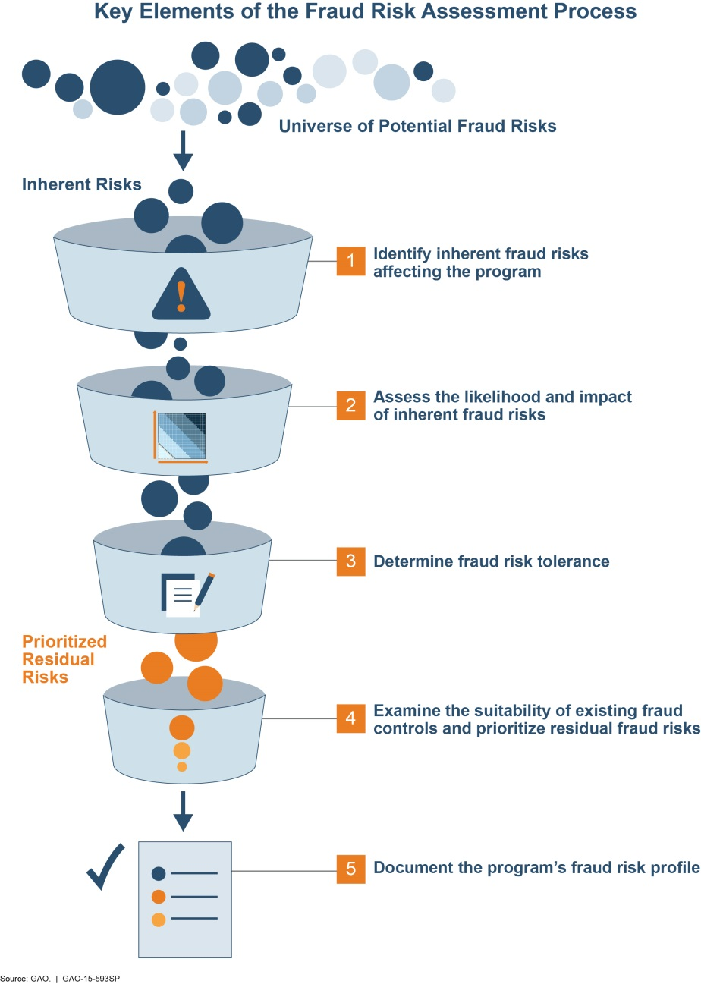
Module VIII: Key Elements of Fraud-Risk Assessment

Slide 18
Module VIII: Component #2—Assess
Part 2: Risk Profile
Compile risk profile by synthesizing and documenting results of assessment(s) as the vital precursor for crafting an effective anti-fraud strategy—key considerations and activities include (see Addendum 2 for further details)
  Inventory of fraud risks (portfolio)
  Description of risk factors
  Identification of risk owners
  Quantification of risk likelihood and impact
  Determination of risk significance
  Description of existing mitigation controls (response)
  Inventory of residual (net) risk
  Determination of significance of residual risk
  Description of new mitigation controls

Slide 19
Module IX: Component #3—Design & Implement (Strategy)
Use results of risk assessment and risk profile to craft and implement a fraud-mitigation strategy (roadmap for action), with appropriate controls—key considerations and activities include (see Addendum 3 for further details)
  Communicate strategy to internal and external stakeholders and risk owners and obtain buy-in & commitment to success
  Establish outcome-oriented, risk-appropriate performance metrics to gauge impact of control activities (how will the needle move?)
  Evaluate costs and benefits of individual control activities and aggregate (systems of) controls
  Establish integrated networks to ensure meaningful vertical and horizontal collaboration with stakeholder community
  Create incentives (carrot-and/or-stick) to encourage action and sustain results over long term

Slide 20
Module X: Component #4—Evaluate & Adapt
Evaluate effectiveness of strategy and adjust to respond to performance gaps & changing operational circumstances and emergence of new risks—key considerations and activities include (see Addendum 4 for further details)
  Monitor effectiveness in real time against performance metrics, focusing on outcomes achieved (has the needle moved?)
  Conduct periodic evaluations of all fraud risk-management components and identify material gaps
  Collect, synthesize, and leverage data & information to create knowledge feedback/learning loop [corroborate]
  Use evaluation results to, as necessary, adapt fraud-risk management activities and communicate to stakeholder community

Slide 21
Case Studies in Fraud-Risk Management
(Takeaways from Recent GAO Audits)
Control weaknesses underscore fraud risks
  Affordable Care Act (ACA) enrollment
  Medicare service-provider enrollment
Applying Framework highlights capability gaps
  Social Security Administration disability benefits
  Immigrant-investor visa program (EB-5)

Slide 22
Case Study: Undercover Tests of ACA Enrollment
Highlights the role of investigative techniques to probe controls for three coverage years
10+ million enrollees, $60+ billion in annualized subsidies
53 of 55 undercover attempts at enrollment successful; 2 attempts intentionally abandoned
$130,000 in subsidized health-care policies secured (annualized)
Bottom line: ineffective controls across spectrum undermined program integrity

Slide 23
Case Study: Data Analytics of Medicare Provider Enrollment
Highlights the use of deep data analytics (matching, mining, mapping, visualizing) to uncover indicators and patterns of potential fraud
About 1.8 million enrolled providers (physicians, hospitals, pharmacies, etc.) filing claims of $600+ billion annually for services and products
Found ~ 24,000 of those sampled to be potentially ineligible based on various indicators (e.g., unconfirmed location, licensure status flags, etc.)
Referred hundreds of potentially ineligible providers (from analytical sample) to agency for review & investigation
Bottom line: Multiple control weaknesses allowed potentially ineligible providers to enroll in lucrative market

Slide 24
Case Study: Review of Social-Security Disability Benefits
Highlights GAO’s initial application of its Framework to SSA’s fraud-risk management model to gauge its maturity
Focus on disability-insurance programs, totaling $200+ billion in annual expenditures, and millions of beneficiaries
Found agency risk model to be evolving and not sufficiently mature to address multiple program risks
Recommended actions related to risk assessment, anti-fraud strategy, and outcome-oriented risk metrics
Bottom line: relatively unserious attempt at fraud-risk management undermines overall mission

Slide 25
Case Study: Review of Immigrant-Investor Program
EB-5 grants US residency (“Green Cards”) to foreign nationals who invest in jobs-generating projects, primarily in economically distressed areas in the country
Explosive growth in applications since “Great Recession,” combined with other enabling factors (e.g., corruption crackdowns in native countries)
Program faces multiple internal and external risks (e.g., project-related securities fraud; lack of visibility into financial and personal backgrounds of applicants)
Recommendations included performing risk assessments, expanding information collection & data-analytics, and reliably reporting on economic benefits
Bottom line: mitigation efforts do not match up convincingly with multiple program & national-security risks facing EB-5

Slide 26
Open Discussion
Revisit earlier matters for further exploration
Share common experiences & insights
Other matters of interest

Slide 27
Concluding Thoughts
Sum up what transpired
What does it all mean
Charge going forward

Slide 28
Addenda
Addendum 1: Risk assessment template
Addendum 2: Risk profile template
Addendum 3: Fraud-risk strategy template
Addendum 4: Evaluate-and-adapt (strategy) template
Addendum 5: Most common schemes of health-care fraud in United States
Addendum 6: GAO High-Risk List

Slide 29
Addendum 1: Risk Assessment Template
Risk Assessment Process
Identify inherent fraud risks affecting a program and component activities
  Define “inherent” risks as those that exist absent a management response
  Answer questions such as: what are specific risks, what makes them so (risk factors), and where could they occur?
Quantify the likelihood and impact of inherent risks actually materializing
  Designate an appropriate quantification scheme of likelihood—e.g., scale of x to y (e.g., expressed as a percentage)
  Designate an appropriate quantification scheme of impact—e.g., financial, reputational
Determine risk thresholds and tolerances
  Define threshold (AKA “appetite”) as the amount of risk an enterprise is willing to accept in its programs in terms of, for example, incurring financial losses; also, define extent of risk avoidance, sharing (transfer), and reduction
  Define tolerance as the deviation from the risk threshold an enterprise is willing to accept during course of program performance relative to achievement of objectives [see slide 30 for an example of what constitutes “tolerance”]

Slide 30
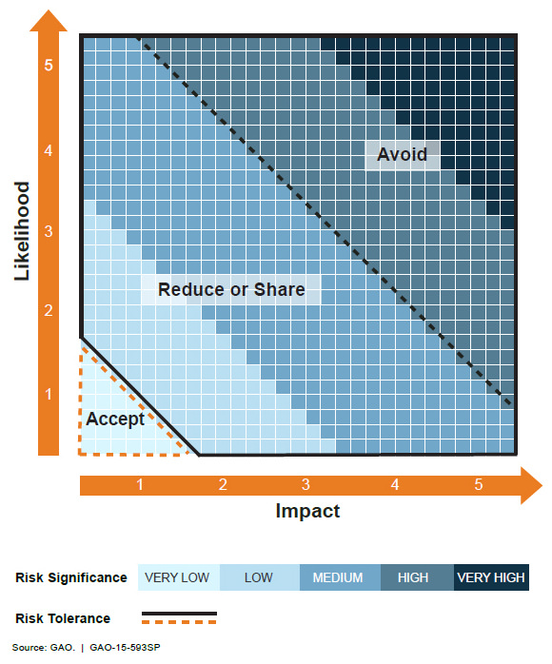
Addendum 1: Illustration of Risk Tolerance Definition

Slide 31
Addendum 1: Risk Assessment Template (Continued)
  Risk Assessment Process (Continued)
Examine suitability of existing risk-mitigation controls
  Determine whether current controls & measures are appropriate in design and placement for the risks they are expected to mitigate
Prioritize residual fraud risks
  Identify remaining risks, i.e., net of mitigation of inherent risks
  Quantify likelihood and impact and prioritize for action
Compile and synthesize information gleaned from assessment process
  Array analyses, key findings, conclusions, and action items in preparation for creating a risk profile
Assessment insight: analyze risks within the context of a program’s relation to an enterprise’s strategic, operational, reporting and compliance objectives; which may occasionally overlap

Slide 32
Addendum 1: Risk Assessment Template (Continued)
Considerations for Risk Assessment
Customize assessment to unique attributes & complexity of target program—one size does not fit all!
Perform systematically at regular intervals; go “out-of-cycle” as events warrant—this is not a one-and-done proposition!
Leverage what is known (quantitative & qualitative information from prior analyses, investigations, etc.)
Make informed judgments about potential “hidden” and future risks (i.e., speculative extrapolation from known facts)
Identify and interpret any linkages between risks and determine cascading effects that exacerbate original risk

Slide 33
Addendum 1: Risk Assessment Template (Continued)
Considerations for Risk Assessment (Continued)
Involve all stakeholders who “touch” program in a substantial way and are familiar with its risks and incorporate input as part of vertical/horizontal integration—avoid silos!
Corroborate, to the extent feasible, testimonial evidence with data & documentation; employ “reasonable assurance” standard and note analytical limitations and their implications
Quantify impact, in terms of program funds or other quantitative measures at risk; qualify impact, in terms of erosion of institutional reputation & public trust
Create feedback loop to inform future decision-making

Slide 34
Addendum 1: Risk Assessment Template (Continued)
Key Questions to Inform Assessment
Is the program (or components) new to the agency and what is the level of institutional maturity?
Does the program have a history of fraud risk, including actual adverse events and deficiencies with material impacts?
Has an Inspector General or other independent entity found and reported on program risks and instances of fraud?
How has the agency responded to such findings and recommendations for remediation? Impact of actions taken?

Slide 35
Addendum 1: Risk Assessment Template (Continued)
Key Questions to Inform Assessment (Continued)
How complex is the program? [Consider as principal driver of risk]
  What is the stakeholder universe and how does it interact during program transactions (e.g., beneficiaries, providers, suppliers, administrators, etc.)?
  What are the program’s “mechanics” (e.g., implementing regulations, eligibility rules, administrative processes & procedures, volume of transactions, service & payment velocity, etc.)?
  In addition to any basic control activities in place, what is the program’s internal/external oversight & accountability structure and how engaged is it (e.g., reviews, approvals, etc.)?
  What are some intangibles—e.g., how frequently do program rules/authorities change, how well aware of and trained are staff on fraud-risk responsibilities, to what extent can management override controls, etc.)

Slide 36
Addendum 2: Risk Profile Template
A risk profile is the essential element for crafting a comprehensive fraud-risk strategy which will drive the mitigation actions necessary to manage risks in a proactive manner
Creating a detailed profile enables risk owners to, among other things, understand linkages between various risks and any interacting/cascading (downstream) effects and craft targeted responses

Slide 37
Addendum 2: Risk Profile Template (Continued)
Risk Profile Components & Some Key Questions
Inherent fraud risks—what fraud risks does the program face? Provide detailed descriptions of origins, manifestations, trends, etc.
Risk factors—what conditions (internal and external) yield fraud risks? Describe extent to which these factors interact to exacerbate risk
Risk owners—which individuals and/or entities who “touch” a program are responsible for addressing its risks? Establish chain of command
Likelihood & impact—what is the probability of a risk occurring and what are the effects? Use an appropriate scale for each (%, $, L-M-H, etc.)
Significance—what is the relative importance (criticality) of the risk to the proper functioning of the program? Use an appropriate scale to describe

Slide 38
Addendum 2: Risk Profile Template (Continued)
Existing controls—what controls are already in place to help reduce the likelihood and impact of each risk? Map out placement/sequencing & identify gaps
Residual risk likelihood & impact—what is the risk net of the mitigating effect of controls in place? In addition to effect, evaluate control design and placement
Risk significance—what is the relative importance of the net risk to the proper functioning of the program? Use an appropriate scale to describe
Risk response—what additional controls are needed to close gaps & mitigate net risk? Measure against risk threshold and tolerance levels established earlier

Slide 39
Addendum 3: Fraud-Risk Strategy Template
Key elements of an anti-fraud strategy—delineate (see “leading practices”)
  Why is fraud-risk management important
  Who is responsible
  What is being done
  When is implementation
  Which are the areas of focus

Slide 40
Addendum 3: Fraud-Risk Strategy Template (Continued)
Leading practices for crafting an effective strategy
Drawing from the risk profile, perform the following
  Set clear, achievable mitigation objectives; synced w/mission
  Determine resource allocation commensurate with risk
  Establish clear roles &responsibilities for implementing strategy
  Create plan to communicate strategy to stakeholders
  Establish milestones and timelines for implementation
  Establish outcome-oriented, risk-appropriate performance metrics
  Highlight key linkages among prioritized risks & implications
  Place anti-fraud strategy in context & link with other risk efforts (ERM)
  Focus on preventative controls and weigh costs/benefits
  Design controls and place/sequence them appropriately

Slide 41
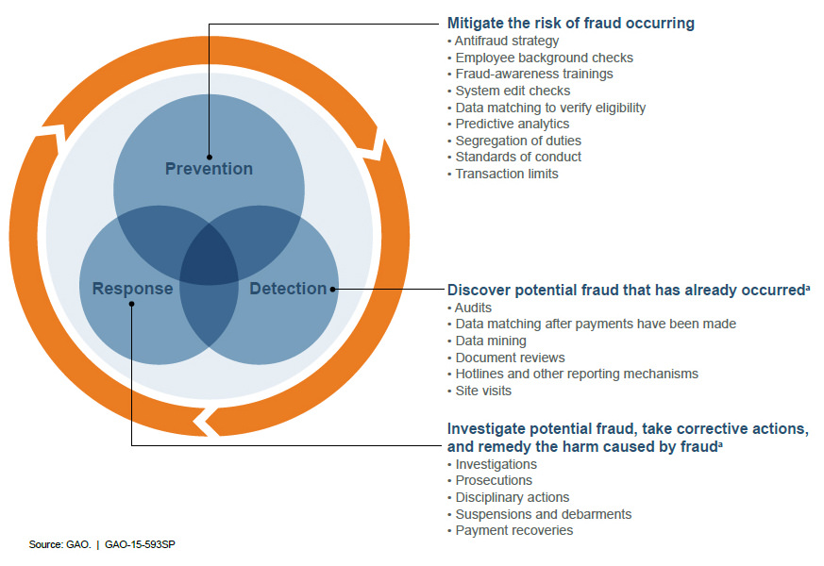
Addendum 3: Examples of Control Activities by Core Principle

Slide 42
Addendum 3: Fraud-Risk Strategy Template (Continued)
Leading practices for crafting an effective strategy
Align controls & related activities along the following integrated categories
  Verification processes & procedures
  Data analytics
  Fraud awareness
  Reporting mechanisms
  Employee integrity
Develop plan for responding to detected instances of potential fraud
  Refer instances to Inspectors General, law enforcement, or prosecutors for additional action, resolution & disposition

Slide 43
Addendum 4: Evaluate & Adapt Template
Leading Practices for Evaluating & Adapting Fraud-Risk Initiatives
Monitor & evaluate all components of fraud-risk management activities
  Review risk assessments, profile, strategy, controls
  Analyze data from reporting mechanisms, instances of detected fraud
  Consider changes in internal & external operational environments
  Engage with stakeholder community to obtain 3rd-party insights
Measure outcomes against metrics established in strategy
  Track and benchmark outcomes against metrics (as function of activities & outputs)—did the “needle” move in the right or expected direction
  Ensure sufficiency of relevant data and corroborating testimonial & documentary evidence to help reach definitive conclusions

Slide 44
Addendum 4: Evaluate & Adapt Template (Continued)
Leading Practices for Evaluating & Adapting Fraud-Risk Initiatives
Adapt activities across full spectrum of risk management process
  Use monitoring and evaluation results (e.g., analyses, detected fraud, investigations, adjudications, etc.) to update design & implementation of entire complement of fraud-risk management initiatives
Communicate & explain results to all relevant owners & stakeholders
  Help maintain engagement and ownership of fraud-risk management process

Slide 45
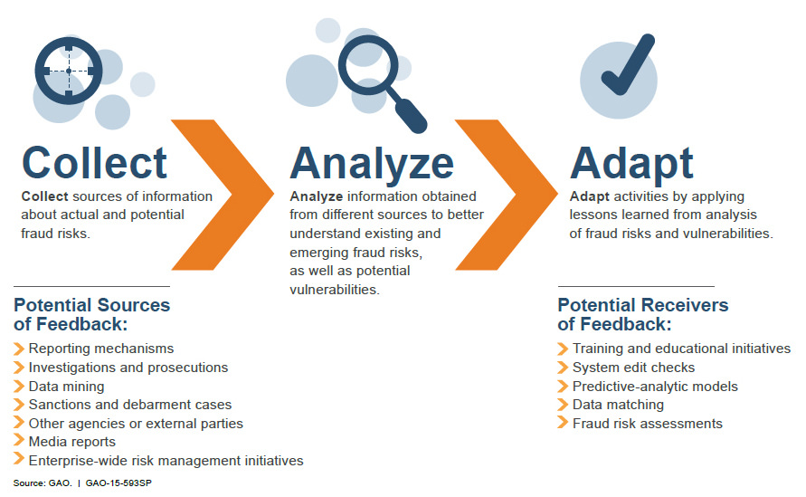
Addendum 4: Illustration of “Evaluate & Adapt” Process

Slide 46
Addendum 5: Most Common Schemes of Health-Care Fraud in United States
Health-care fraud in federal programs is focus of extensive audit & investigative activity in United States
Top schemes (often in combination with multiple schemes, thus % do not = 100) (239 total individual schemes, based on 2010 data)
  Billing for services or supplies not provided (43%)
  Billing for medically-unnecessary services (25%)
  Falsifying records in support of a scheme (25%)
  Paying kickbacks to scheme participants (21%)
  Improperly obtaining controlled substances/misbranding prescription drugs (21%)
Extent of complicity
  Service providers complicit in 62% of cases
  Beneficiaries complicit in 14% of cases

Slide 47
Addendum 6: GAO High-Risk List
The GAO HRL is a biennial compilation of US federal programs at heightened risk for fraud/waste/abuse/mismanagement
The 2017 iteration includes 34 distinct program areas in need of significant risk mitigation through a combined function of
  Leadership commitment
  Agency capacity
  Action plan (strategy)
  Monitoring
  Demonstrated progress

Slide 48
Addendum 6: GAO High-Risk List (Continued)
Selected HRL areas of interest
  Management of IT acquisitions & operations
  Government environmental liabilities
  Strategic human capital management
  Defense financial management
  Defense weapon system acquisition
  Oversight of food safety
  NASA acquisition management
  Enforcement of tax laws
  Medicare & Medicaid health programs

